Slide 1
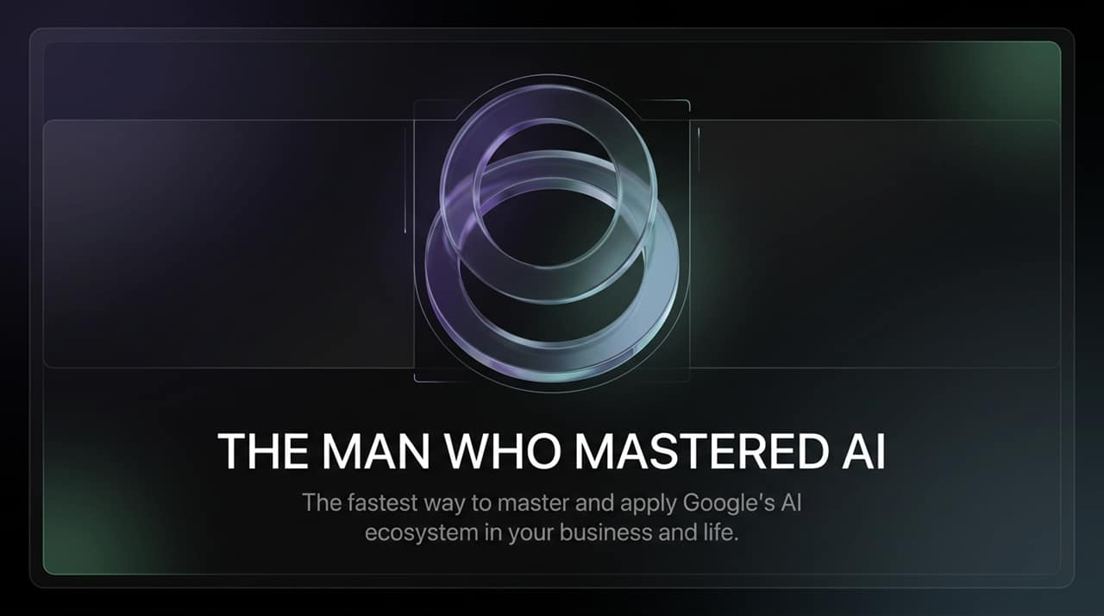
Notes:
Welcome everyone. Today, we're diving into how to give your Google tools an 'AI Brain' and master the Google AI ecosystem to transform both your business and daily life.
When most people talk about AI today, they immediately think of ChatGPT or Claude. But as former lawyer turned top e-commerce entrepreneur and AI creator Paul Lipsky points out, Google has built an extraordinarily powerful, end-to-end AI suite that many people are completely sleeping on. Today, we are going to look at the practical framework to master Google Gemini, NotebookLM, and Google AI Studio—turning everyday software into an automated productivity engine.
https://www.youtube.com/watch?v=aq_-15fCd-0

Slide 2
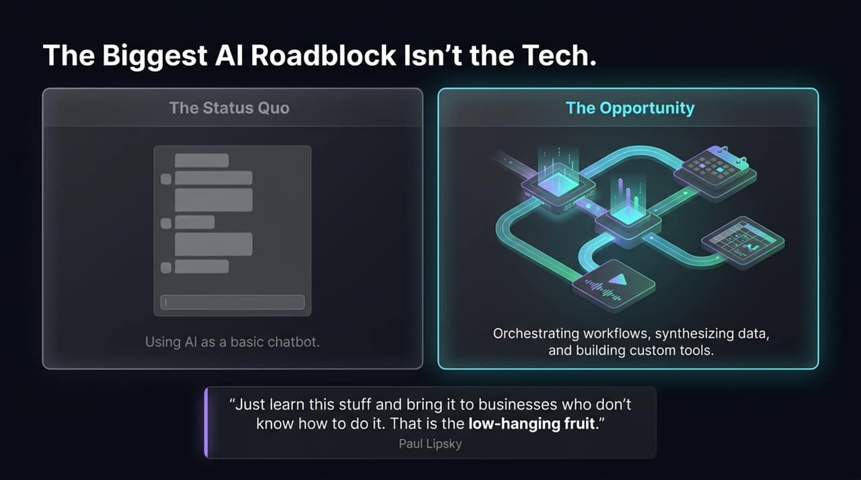
Notes:
Let's address the elephant in the room: why aren't more businesses scaling with AI? The problem isn't that the technology isn't ready—it's how people are using it.
The Status Quo for most users is treat AI as a glorified search bar or basic chatbot—asking simple questions and receiving text paragraphs back.
The real Opportunity lies in moving from passive chat to orchestrating entire workflows, synthesizing complex data, and building custom internal tools without code.
Paul Lipsky highlighted a massive market gap: most business owners and legacy companies don't know how to implement these tools. As Paul puts it, 'Just learn this stuff and bring it to businesses who don't know how to do it. That is the low-hanging fruit'. If you learn how to bridge this knowledge gap, you possess an incredible unfair advantage.

Slide 3
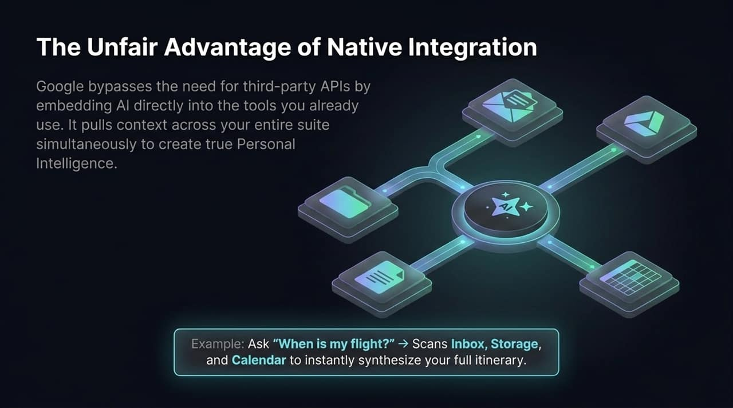
Notes:
What makes Google’s AI ecosystem distinctly different from standalone models like ChatGPT or Claude? It comes down to Native Integration.
Standalone tools require third-party API connections, manual copying and pasting, or re-uploading files repeatedly. Google bypasses all of that by embedding AI directly into the G-Suite tools you already use daily—like Gmail, Drive, Calendar, Docs, and Sheets.
It operates on Personal Intelligence. By enabling Google Connected Apps, Gemini simultaneously pulls context from across your entire suite in real time. For example, if you ask, 'When is my flight next month and build me an itinerary?', Gemini scans your Gmail inbox for airline confirmation emails, checks your Calendar for existing appointments, and references your Google Docs to instantly synthesize a full itinerary.

Slide 4
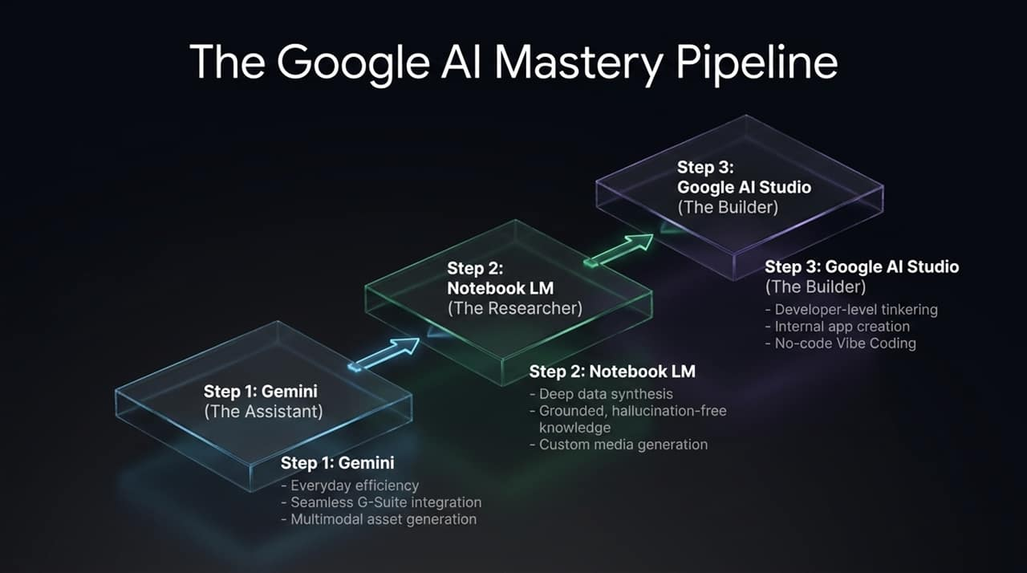
Notes:
To master the Google AI ecosystem, you don't need to learn dozens of disparate applications. You only need to understand a simple 3-step pipeline:
Step 1: Gemini (The Assistant) – This is your central hub for everyday efficiency. It handles seamless G-Suite integration, rapid multimodal content creation (images, music, talking video avatars), and basic chat.
Step 2: NotebookLM (The Researcher) – This is your dedicated research engine. Unlike general chatbots, NotebookLM performs deep data synthesis on uploaded documents, providing 100% grounded, hallucination-free knowledge and instant custom media generation.
Step 3: Google AI Studio (The Builder) – When you're ready to move beyond basic assistant tasks, AI Studio provides developer-grade tinkering without requiring technical expertise. It allows you to 'Vibe Code' custom internal business tools using plain English.

Slide 5
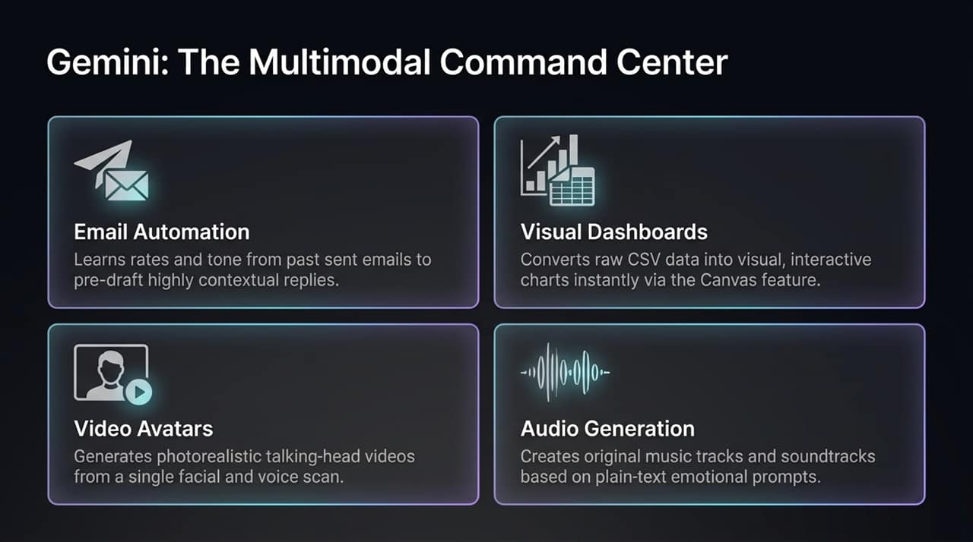
Notes:
Let's look closely at Gemini, which serves as your multimodal command center.
Email Automation: Gemini learns your pricing rates, tone of voice, and communication structure from your past sent emails. It automatically pre-drafts replies to inbound brand or client emails directly inside Gmail.
Visual Dashboards: Using the Canvas feature, Gemini can take raw CSV sales data or marketing spreadsheets and instantly convert them into interactive visual graphs and executive dashboards.
Video Avatars: Gemini features custom video avatar generation. From a single face and voice scan, you can generate photorealistic talking-head videos with natural camera movement and speech, perfect for quick explainer videos or ads.
Audio & Music Generation: You can generate custom music tracks and sound effects based purely on plain-text emotional prompts.

Slide 6
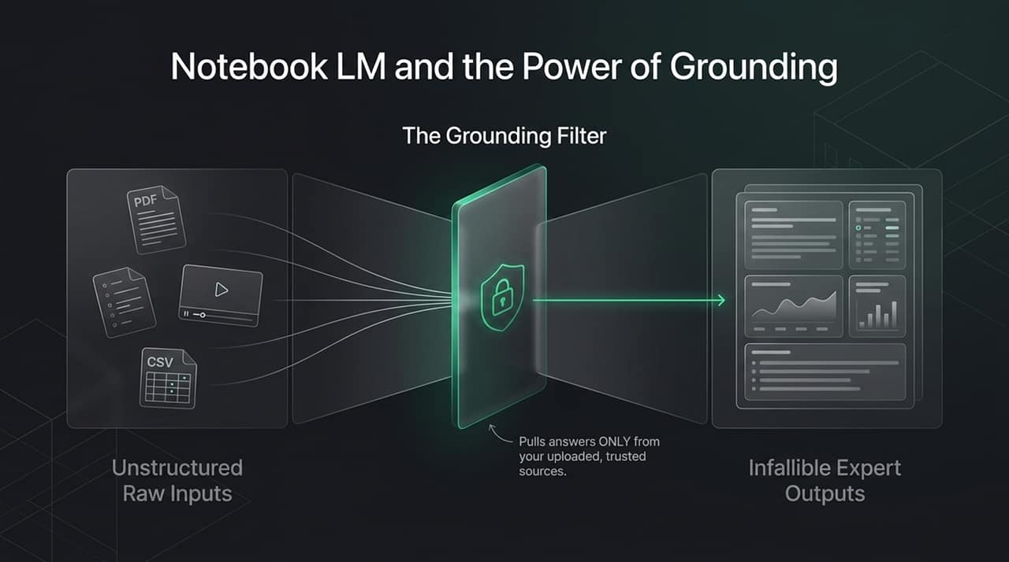
Notes:
Now let's examine Step 2: NotebookLM. The single biggest superpower of NotebookLM is Grounding.
When you use traditional LLMs, they draw from the open internet, which often leads to inaccurate answers or hallucinations. NotebookLM acts as a strict filter.
You feed it unstructured raw inputs—such as PDFs, CSVs, YouTube links, Google Docs, or research papers. The Grounding Filter forces the model to draw answers ONLY from your uploaded, trusted sources. It effectively creates an infallible subject-matter expert on your exact data.

Slide 7
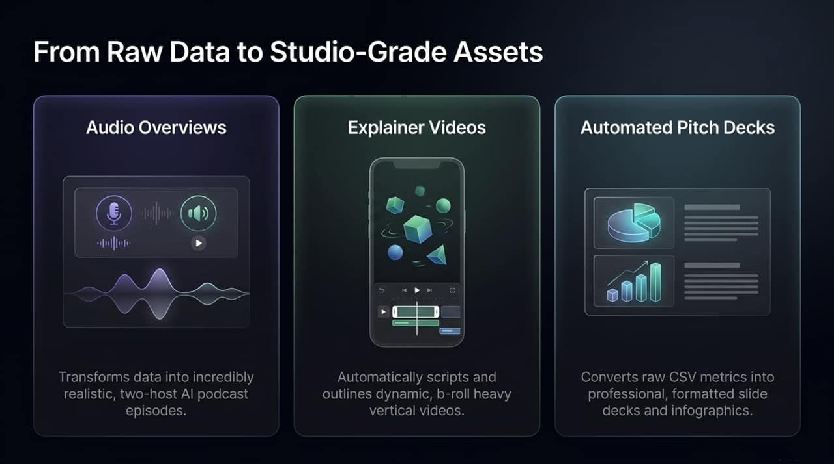
Notes:
Once your data is grounded inside NotebookLM, you can instantly turn raw text into studio-grade media assets with single-click actions:
Audio Overviews: Converts your documents into hyper-realistic, two-host AI podcast discussions where hosts banter, unpack complex topics, and summarize your data dynamically.
Explainer & Short Videos: Scripts, outlines, and generates b-roll-heavy explainer videos and vertical shorts optimized for mobile learning or content creation.
Automated Pitch Decks & Infographics: Analyzes uploaded business metrics or corporate reports and formats them into clean slide decks and infographic visual summaries.

Slide 8
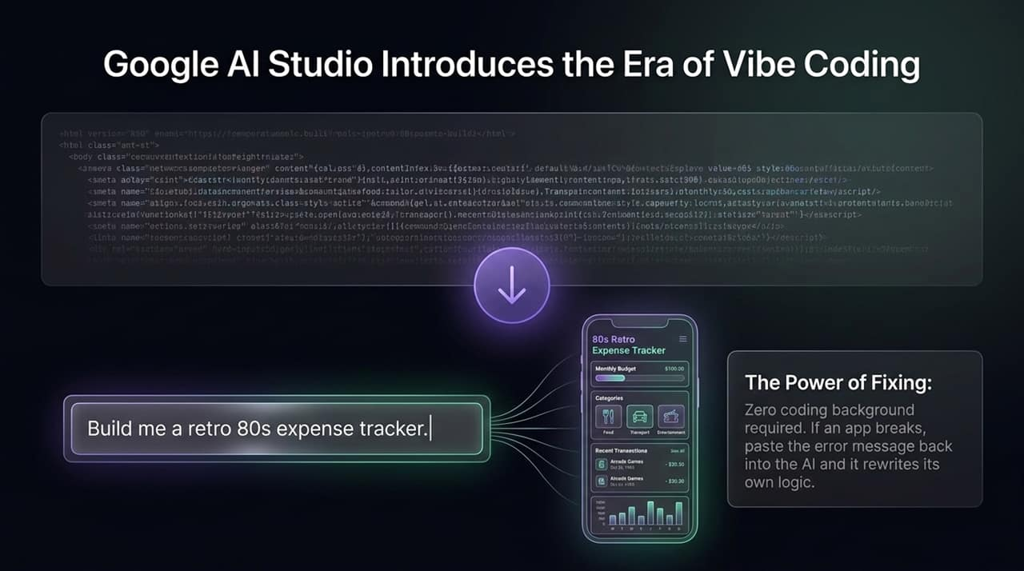
Notes:
Now we arrive at Step 3: Google AI Studio and the era of Vibe Coding.
Historically, building business apps required software engineering. Today, you can simply type a prompt describing what you want—for example, 'Build me a retro 80s expense tracker'—and the platform generates a fully working web application.
The real magic is The Power of Fixing. Zero coding background is required. As Paul Lipsky demonstrated, if an app throws an error code, you don't need to understand it. You simply copy and paste the error message back into the AI, and it rewrites its own logic to fix the bug instantly.

Slide 9
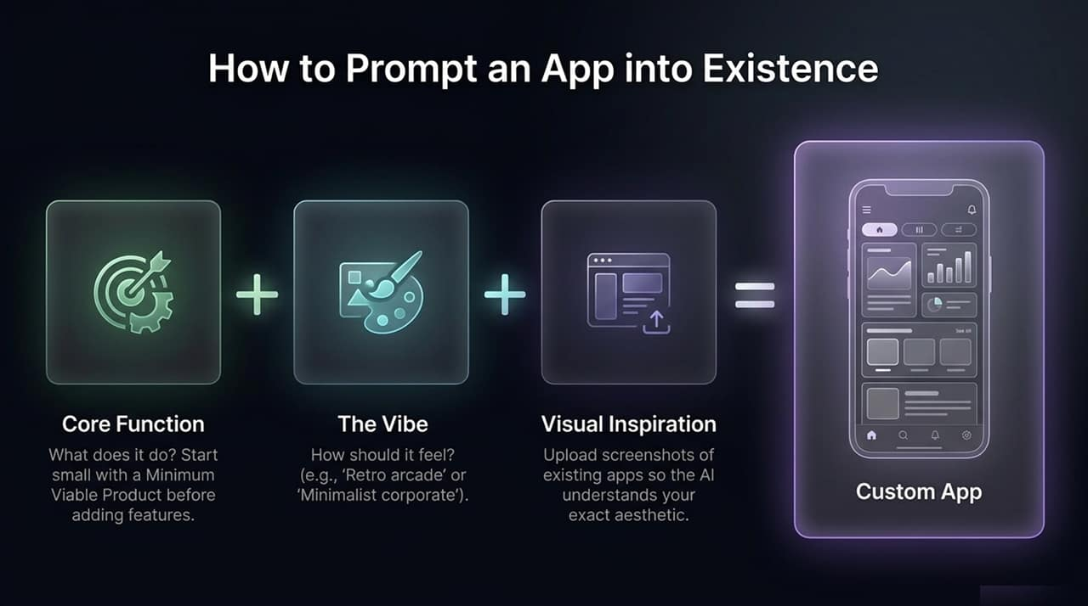
Notes:
When Vibe Coding an application, how do you construct the perfect prompt? Use this 3-part formula:
Core Function + The Vibe + Visual Inspiration = Custom App
Core Function: Define what the app does. Always start with a Minimum Viable Product (MVP) before adding complex features.
The Vibe: Describe how the interface should feel (e.g., 'Retro 80s arcade', 'Clean corporate minimalist').
Visual Inspiration: Upload screenshots of existing designs or layouts you like so the AI understands your target aesthetic.

Slide 10
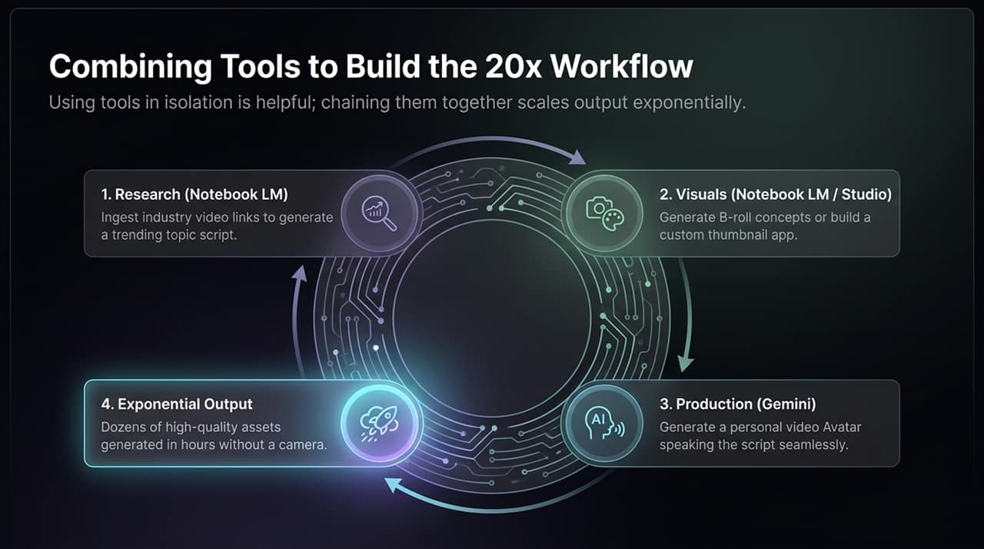
Notes:
Using any single AI tool in isolation yields modest productivity gains. But chaining these tools together exponentially scales your output—creating a 20x content and business workflow:
Research (NotebookLM): Ingest research papers or industry YouTube links to identify trends and generate a refined video script.
Visuals (NotebookLM / Studio): Generate B-roll concepts or build a custom thumbnail app to create visual assets.
Production (Gemini): Feed your script into your personalized Gemini Video Avatar to produce a clear talking-head video without turning on a camera.
Exponential Output: Dozens of high-quality assets produced in hours, completely camera-free and with zero coding.

Slide 11
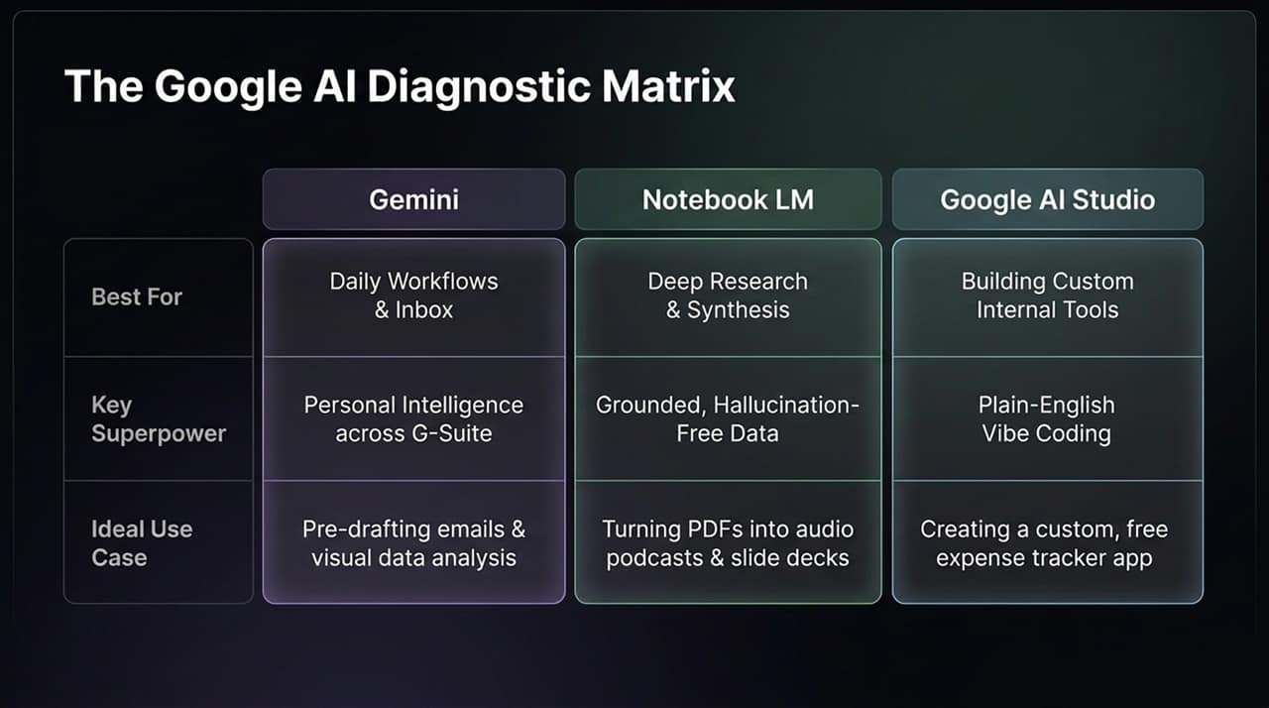
Notes:
To keep your team focused, use this Diagnostic Matrix to decide which tool to deploy for a given challenge:
Gemini: Best for daily workflows and inbox management. Superpower: Personal Intelligence across G-Suite. Ideal use case: Pre-drafting email replies and visual data analysis.
NotebookLM: Best for deep research and data synthesis. Superpower: Grounded, hallucination-free output. Ideal use case: Turning long PDFs/CSVs into audio podcasts, shorts, or slide decks.
Google AI Studio: Best for custom internal tools. Superpower: Plain-English Vibe Coding. Ideal use case: Building custom, free web apps like budget trackers or thumbnail generators.

Slide 12
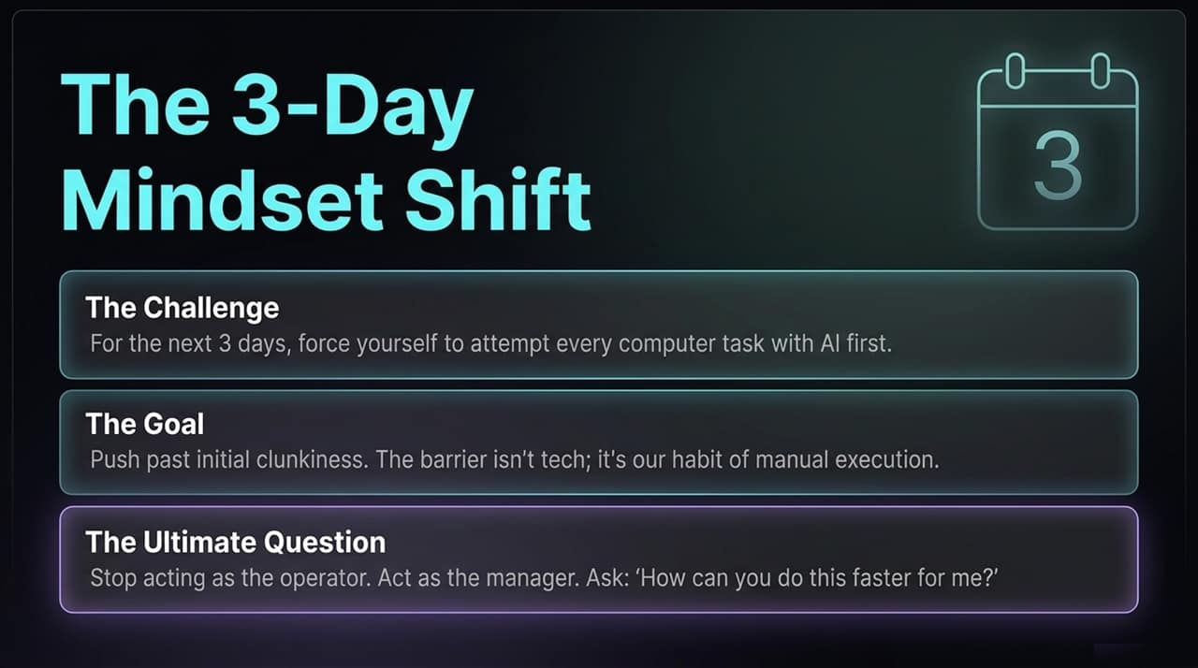
Notes:
To truly adopt this system, you must undergo a 3-Day Mindset Shift:
The Challenge: For the next 3 days, force yourself to attempt every computer task with AI first.
The Goal: Push past the initial clunkiness. The real barrier to AI adoption isn't technical complexity—it's our muscle memory of manual execution.
The Ultimate Question: Stop acting as the operator typing out every line. Act as the manager. Constantly ask your AI: 'How can you do this faster for me?'"

Slide 13
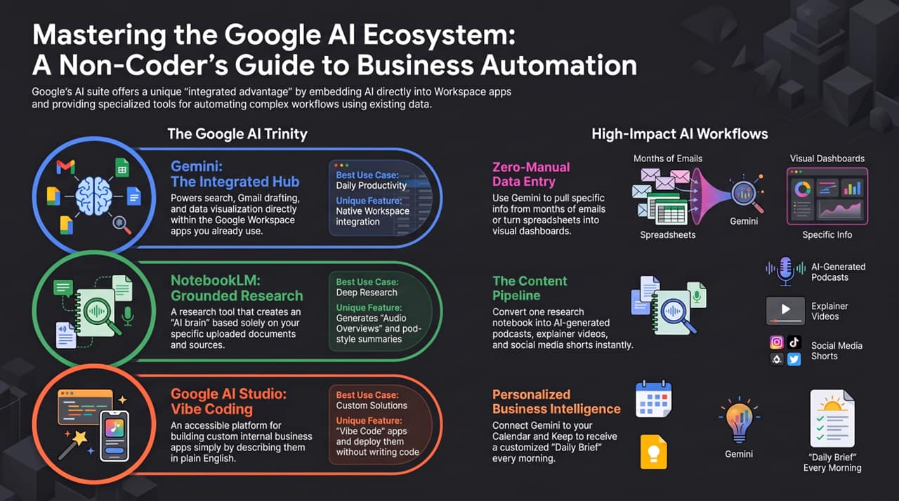
Notes:
To wrap up, Google offers a non-coder's gateway to total business automation.
Remember the Google AI Trinity:
Gemini: Your integrated daily productivity hub.
NotebookLM: Your grounded research engine.
Google AI Studio: Your no-code solution builder.
By shifting your workflow to zero-manual data entry, converting raw notebooks into dynamic content pipelines, and setting up personalized business intelligence briefs every morning, you can operate at 20x capacity starting today. Thank you!"

